Slide 1

Digital portfolio
STUDENT NAME: Mahalakshmi N
REGISTER NO AND NMID: 2422j0219 and asbrubd2422j0219
DEPARTMENT : Bachelor of Computer Applications COLLEGE :Shree Venkateshwara College of Arts and Science Afﬁliated by Bharathiyar University

Slide 2
PROJECT TITLE
STUDENT
DIGITAL
PROTFOLIO

Slide 3


Agenda
1.ProblemStatement
2.Project Overview
3.End Users
4.Tools and Technologies
5.Portfolio design and
Layout
6.Feautures and Functionality.
7.Results and Screenshot .
8.Conclusion.
9.Github Link

Slide 4

Problem Statement
Students need a better way to showcase their skills, projects, and achievements. A digital portfolio helps present this information clearly and professionally for internships, jobs, or higher studies.

Slide 5

Project overview
A student portfolio is a personal website built using HTML, CSS, and JavaScript to showcase a student's skills, projects, achievements, and contact details in an attractive and professional way.

Slide 6
Who are the end users?
College faculty – to assess the student’s work and skills.
Recruiters/employers– to evaluate the student for internships or jobs.
Peers/classmates– for collaboration and feedback.
Admissions teams – for higher studies or scholarships.
The student themselves– to track their own progress and achievements.

Slide 7



Tools And Techniques
Tools Techniques
1.HTML – Structure the web pages
2.CSS – Style and design
3. JavaScript– Add interactivi
4.VS Code– Code editor
5.Git & GitHub – Version control and deployment
6.Browser DevTools– Debugging and testing
7.Canva / Figma – UI/UX design mockups *(optional)*
1.Responsive Design – Make site mobile-friendly
2.Modular Coding – Organize code clearly
3.Semantic HTML – Use proper HTML tags
4.CSS Flexbox/Grid – Layout design
5.Form Handling– For contact section
6.Testing & Debugging – Check for errors and fix issues

Slide 8


🎨
Portfolio Design And Layout
Support for new design and layout means helping to create fresh, user-friendly, and attractive interfaces that improve user experience and make the portfolio easy to navigate.

Slide 9
Features And Functionality
Responsive design (works on all devices)
Navigation menu for easy browsing
Project gallery with images and descriptions
Skill list to showcase abilities
Contact form to send messages
Smooth scrolling between sections
Basic form validation on contact form

Slide 10

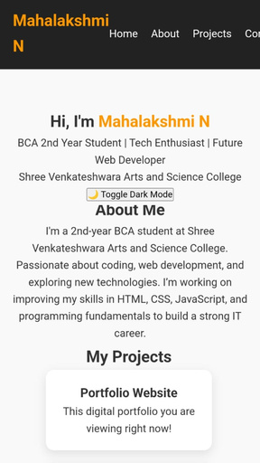
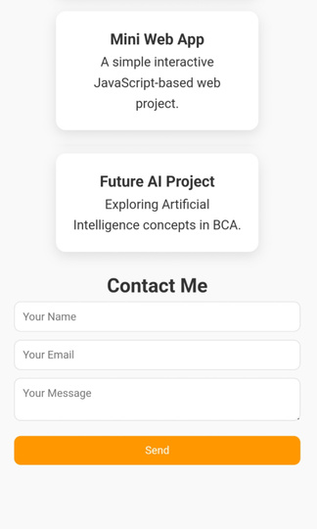
Results And Screenshots

Slide 11
GitHub link
https://github.com/mahabca21/Mahalakshmi-N

Slide 12
Conclusion
This digital portfolio effectively showcases the student’s skills, projects, and contact information in a clear and attractive way. It helps create a strong online presence and makes it easier for others to learn about the student’s work and abilities.

